Slide 1

Time Manager
Your Virtual Personal Assistant
Esther Cui, Zoe Liu, Lingchao Mao, Wenting Zheng
Diamond Hacks | WiCs | NC State University

Slide 2
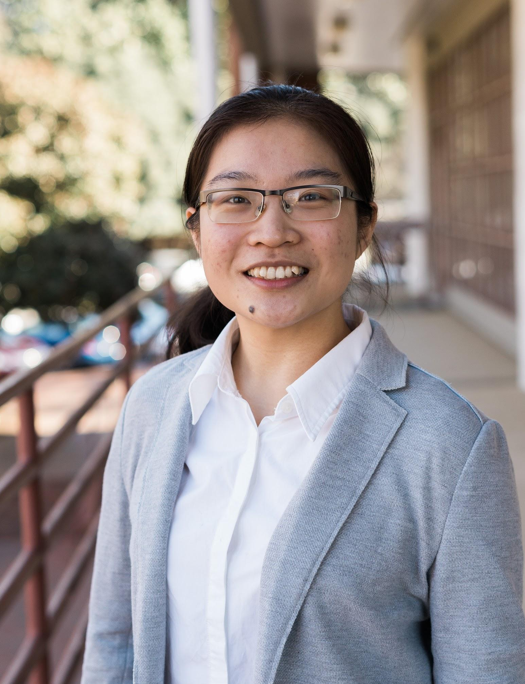

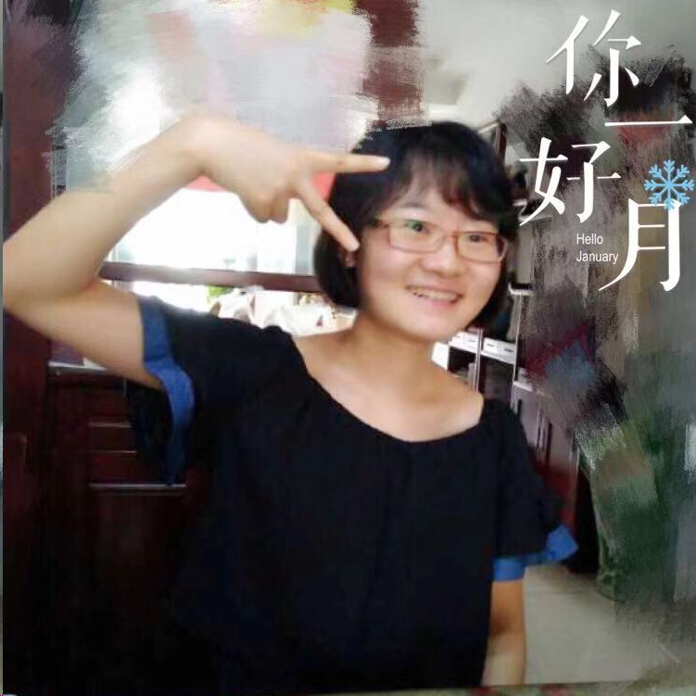
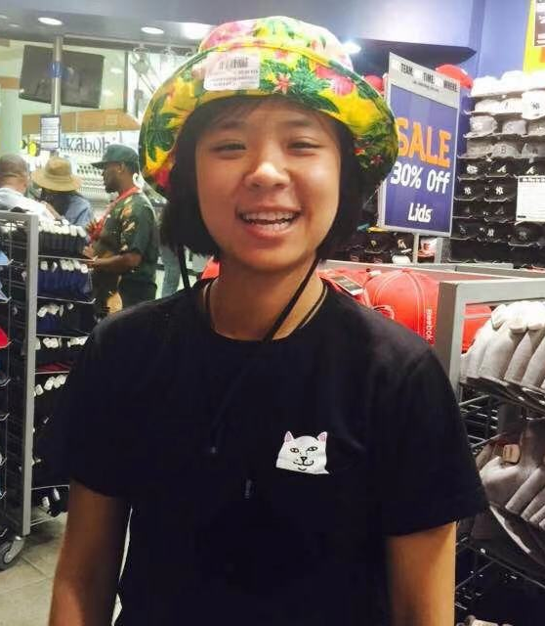
OUR TEAM
Wenting Zheng CSC Senior |  | Lingchao Mao ISE|ST Junior
 | Yuquan Cui CSC Senior |  | Lingchao Mao ECE Senior
Notes:
Name, major, year

Slide 3
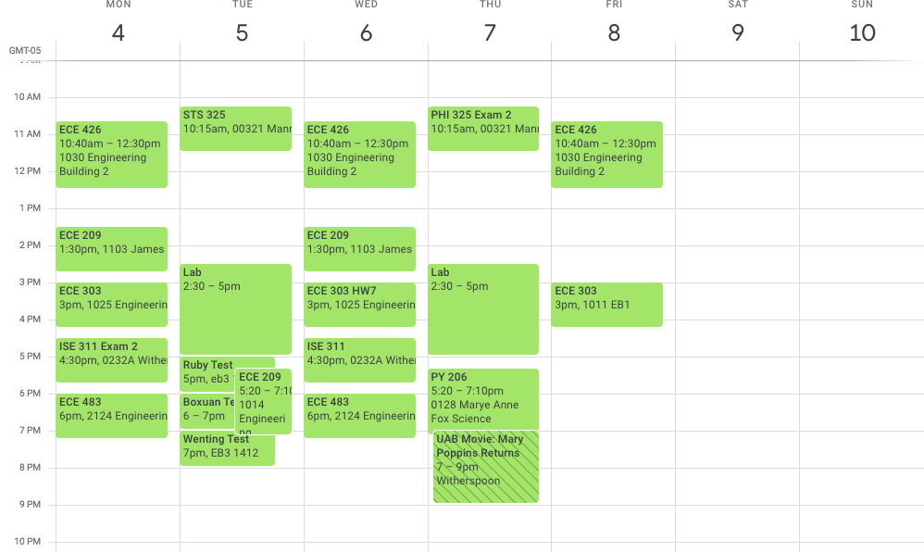
SCHEDULE PROBLEM
To Do List
ENG331 4 pg Paper (3/5)
Physics lab report (3/7)
ECE303 project (3/10)
ISE311 Homework (3/6)
PHI325 Test (3/7)
Research report (3/10)
Car annual inspection
Groceries...
Shopping gift for a friend
Call mom
Notes:
I think Zoe should be here today…
She is a Senior, taking 22 credit hours, doing part-time research, and she has 2 tests next week
That’s her calendar, and that’s the list of things she needs to add to her calendar… plus eating and exercising
(What she does is she would sit at DH Hill Library, thinking whether she should do the most difficult hw first, or the one she feels most comfortable with first, or the one she liked most depending on her mood that morning. Most of the times, this is not an analytical process, and would take from 2 to 10 min of the day, and even longer if she procrastinates

Slide 4
PAIN POINTS
“I have 36 tasks on my to do list, which ones should I do first?”
“I can’t meet this week, my schedule is packed up”
“If I have finished that report yesterday…”
“I didn’t expect it to take 8 hours. stayed up all night…”
“I didn’t get anything done this Friday.”
“My Google Calendar looks bad… and only gets worse”
Notes:
So, have any of the following thoughts ever came to you,
(...)
This already sounds terrible….
And you know what make it worse?? We still procrastinate… until the last minute…. Especially when you have a endless to do list….

Slide 5

OUR SOLUTION
How do they manage to do so many things?
It can take an army to build a business; a team to orchestrate your success and manage each facet of your internal systems and processes.
To solve the problem, you need to hire a personal assistant who charges $200 per day, or you can use a Virtual Personal Assistant to boost your productivity
Free and Accessible
Notes:
Okay, let’s put aside our problems for a minute. There are so many successful people around us! This is an era where everyone seems so successful in every aspect at least on social media right? How can they manage to do so many things! Have you noticed that It can take an army to build your success. A personal assistant is their secret weapon to efficiency, time management and productivity. Okay, I want one too. You could hire a personal assistant to help you and pay $200 at the end of the day. Or, you can use our time manager to automatically link your to do list with your schedule to optimize your calendar.

Slide 6
PROJECT GOALS
Automated
Productive
Smart Task Scheduler
Customized
Boost Productivity
Learn your best Working Style
Notes:
Here, we propose a solution that combines other productivity tools in the market with Machine Learning and Artificial Intelligence to provide customized, automated, and convenient way to boost your productivity. This virtual personal assistant helps you to learn how you work better, when you work more efficiently, and what to do to make the most out of your day.

Slide 7
KEY FEATURES
Model improvement
Tasks
Prediction Model
Suggestion
Schedule
Import Your Schedule of Events
Enter Your To Do List
Prediction Model
Output Suggested Schedule
Closed-loop Feedback
Classes, work, life, sleep, eat
Personalized time blocks
Deadline, priority, difficulty, experience, and interest levels
Regression model to predict duration of a task based on historical data
Optimize your performance
Did you finish the project as expected? Why not?
Notes:
Our solution is your calendar, your to do list and your time management coach. You simply import your calendar, and you can make it as personal as you want. You can set up your working hours, your bedtime and you can layout the entire lifestyle you have or you want to have. And then, you can add your tasks, assignments, appointments and so on into the virtual to do list. Again, the to do list is just for you. You can add details to the tasks such as deadline, priority, difficulty level, your experience level and your interest levels. And then, that’s where magic happens. Our prediction model will analyse your tasks, your schedule and your expectations to predict how long your new tasks will take to give you an idea about what’s coming. From there, your virtual personal assistant will examine your calendar to give you the best suggestions about what to in your free time blocks. As a user, you are the boss of the virtual assistant. You can check off tasks from the to-do list which in return gives you positive reinforcement. And, the automated time manager is constantly collecting data from you to improve the predictions and suggestions. In this closed-loop feedback model, the more you use it the better service you get. Eventually you will be an expert in time management.

Slide 8
PROGRAM COMPONENTS
S1 Identify Free Time Slots
“Time fragmentation”
Personalized time block preferences: work, leisure
S2 Build Prediction Model
Historical data (200+)
Priority, experience, difficulty, and interest levels; task category;
*Physical conditions; time of the day; mood; text mining for task name
S3 Automated Scheduler
Maximize time utilization
Completeness
Feedback & improvement
Real time updates
Notes:
Our program framework is divided into three main components:
First, the program scans over your uploaded schedule and identifies the free time slots, from 5 min blocks to 5 hour blocks. It also asks you for your preferred working range which will be prioritized in the scheduling process
Second, we built a prediction model that analyzes your historical data of tasks, and predicts how long it would take you to do a task. For this demo, we used a linear regression model based off 200 rows of Zoe’s data, which considers priority, task category, experience, difficulty and interest levels. But for a real project scope, we can incorporate lots of predictors including physical conditions, time of the day, weather, mood, pressure level, etc., and use machine learning algorithms to analyze all these little pieces of data that speak to our efficiency levels to predict how will we perform a task, and recommend which time of the day will we do it best
One data is processed, your virtual personal assistant would automatically propose schedules for you.
Realtime -- self-corrects and updates schedule based on your performance and feedback

Slide 9


Slide 10

TARGET USERS
Notes:
Our solutions can benefit students professor CEOs and anyone who has to fit tons of tasks into limited time. It can also improve efficiency at hospitals, restaurants and other business settings. For instance, doctors can use our model to arrange more appointments, restaurants can take more reservations and reduce the waiting time for customers, professionals can set a better meeting times for staffs. And, our solution will move beyond when it’s integrated with other new technology.

Slide 11
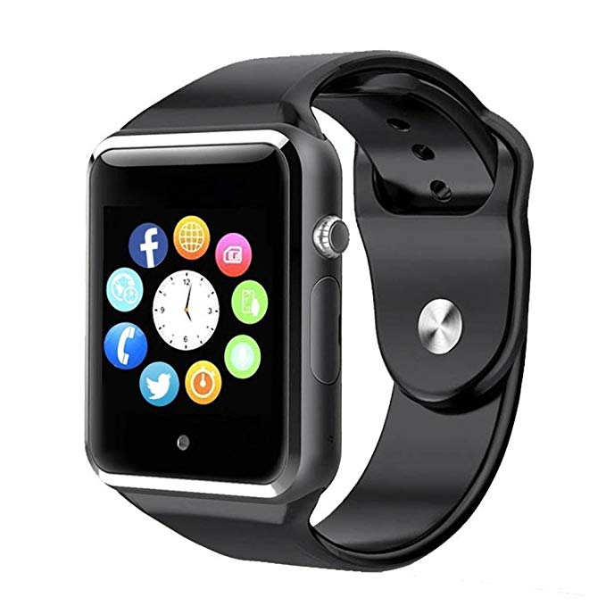
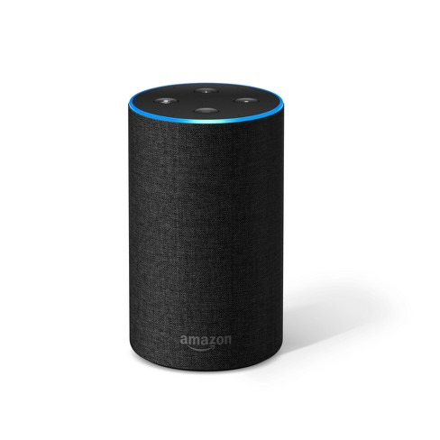
LOOKING TOWARDS THE FUTURE
Integrates Smart Device Data
Task Collaborators
How physical conditions, sleep quality, mood affect predictions
Combine schedules of multiple users
Smart Devices, Smart cities, Smart Life
Time Manager App
Accessibility
All in one Virtual Assistant
Fit tasks within schedule
Hardware devices to conveniently record task times (e.g. log in/off work, enter/leave buildings).
Connect with you Google G Suite, Alexa, Iphone...

Slide 12
THANK YOU
“It’s not enough to be busy, so are the ants. The question is, what are we busy about?”
WiCs, Sponsors, Coders, Designers
Notes:
Many coaches suggest to use time fragments, but that’s easier said than done. For instance, I had 30 minutes break between classes and I just sat there thinking umm which assignment should I do now. Guess what, by the time I analysed all the pros and cons, time is gone! With this time manager, I can just be a no brainer and spend my energy and time on the most important things and get things done even ahead of time

